Slide 1
Economics Chapter 1
What is Economics?
Caution: These notes are NOT intended to replace textbook reading assignments.

Slide 2
The Major Problem of Economics is SCARCITY
All RESOURCES are limited
Human beings have NEEDS and WANTS
Human beings form SOCIETIES to get their needs and wants fulfilled in the most EFFICIENT way possible.
In ECONOMICS, societies are made up of HOUSEHOLDS (CONSUMERS and LABOR), BUSINESSES (ENTREPRENEURS and PRODUCERS) and the GOVERNMENT (regulation, protection, provision of services)

Slide 3
What is Economics?
ECONOMICS is a SOCIAL SCIENCE that studies how human beings and societies use scarce resources to fulfill their needs and wants
Wants and needs are often discussed in connection to how much VALUE and UTILITY something has to fulfill the want and need.
This can lead to a PARADOX of VALUE.
ADAM SMITH explained about what WEALTH is and that people with all their TALENTS and ABILITIES are the true source of wealth is for any nation. He also explained how VALUE is derived in his book WEALTH OF NATIONS (1776)

Slide 4
WANTS and NEEDS
Human beings try to satisfy their WANTS and NEEDS through the use of GOODS and SERVICES
Goods are categorized into CONSUMER GOODS or CAPITAL GOODS, DURABLE GOODS(>3years) or NONDURABLE GOODS(<3years)
Goods and services take up resources
In economics, resources are often called FACTORS OF PRODUCTION (land, labor, capital, entrepreneurs)

Slide 5
CHOICES
CHOICES have to be made because there aren’t enough RESOURCES to satisfy everyone’s wants and needs
The problem of not having enough RESOURCES is called SCARCITY
When we talk about CHOICES we have to make because of SCARCITY, we often talk about what we had to give up to get what we wanted. These choices are called OPPORTUNITY COSTS and TRADE OFFS.

Slide 6
MORE CHOICES
We need to keep in mind that every ECONOMIC ACTIVITY has a COST associated with it.
This concept is illustrated by the acronym TINSTAAFL (There Is No Such Thing As A Free Lunch)
The concept of TINSTAAFL refers to the fact that NO economic product is ever FREE. Someone has to pay for it somewhere: creation, production, shipping distribution, sales, labor, management, and advertising

Slide 7
AND EVEN MORE CHOICES
SOCIETIES make choices; individual people make choices as CONSUMERS; BUSINESSES (FIRMS) make choices; the GOVERNMENT makes choices
The choices that societies have to make about resource USE and PRODUCTION can be summed up into THE 3 QUESTIONS every society must ask itself:
WHAT are we going to produce?
HOW are we going to produce it?
WHO gets what we produce?

Slide 8
We have to ask those questions because resources are scarce
WHAT ARE WE GOING TO PRODUCE?
Guns or butter?
Civilian or military?
Public or private?
In our economy, the answer to the questions is
We will make whatever we think will be PROFITABLE with the resources we have on hand
We will make them in the most PRACTICAL, cost efficient and resource efficient way
Whoever can AFFORD them can get them
HOW ARE WE GOING TO PRODUCE?
Mass produce or piece by piece?
Human beings or robots?
Small business or corporation?
WHO GETS WHAT WE PRODUCE?
The workers who made them?
The military?
Whoever can afford to buy them?

Slide 9
Limited
Resources
Unlimited
Wants
scarcity
choices
WHAT
to produce
HOW
to produce
FOR WHOM
to produce

Slide 10
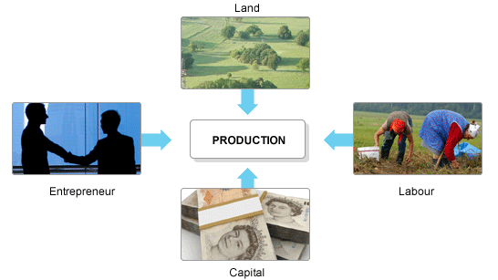
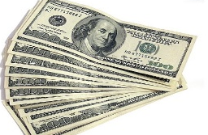
I. Choices PRODUCERS Make – producers need to figure out what resources they will need and the best way to use them. These resources are called the FACTORS OF PRODUCTION
CHAPTER 1- LESSON 2: Our Economic Choices
A. Factors of Production – Resources required to produce the things we want and need. The four factors are LAND,CAPITAL, LABOR, ENTREPRENEURS
Land
Entrepreneurs
Labor
Capital

Slide 11
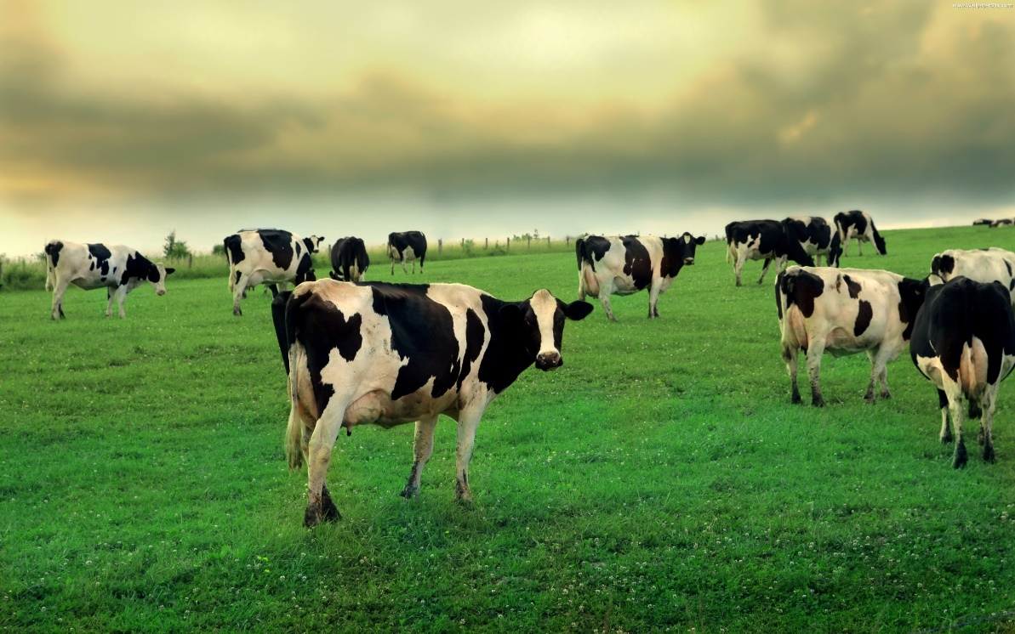
1. LAND – gifts of nature or natural resources not created by people
CLIMATE
Minerals
Ore
LIVESTOCK
Sunshine
FORESTS
Waterways
Deserts

Slide 12
2. CAPITAL – Used in the production of goods and services. There are TWO TYPES.
a. CAPITAL GOODS – tools, equipment, machinery and factories used in the production of goods and services.
Examples:
A bulldozer at a construction site
An OVEN in a bakery
A computer in a classroom
A HAIR DRYER in a salon
An x-ray machine in a hospital
b. FINANCIAL CAPITAL- the MONEY and CREDIT needed to purchase capital goods and other factors of production

Slide 13
3. LABOR – people with all their efforts and ABILITIES and SKILLS who help produce goods and services
Does NOT include ENTREPRENEURS because they are special and are a factor of production all on their own.
Historically, factors such as BIRTHRATE, IMMIGRATION, disease, famine and war have great impacts on the quality and availability of labor.

Slide 14
4. Entrepreneurs- RISK TAKERS in search of PROFITS who do something new with existing RESOURCES.
Responsible for much of the CHANGE, progress and INNOVATION in the economy
They are the driving force or SPARK PLUG of the economy because they start businesses, invent, innovate and bring new products to market.

Slide 15
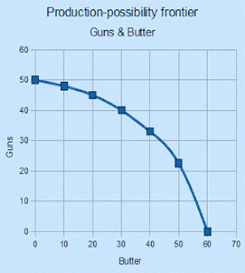
THE PPC or PPF
The choices that a society makes about resource use and production can be illustrated using a PRODUCTION POSSIBILITIES CURVE (FRONTIER)
It is important to know how much we are capable of making as well as what ALTERNATIVES are available to us in production.
Economists use a graph called a PRODUCTION POSSIBILITIES CURVE (PPC), sometimes called a PRODUCTION POSSIBILITIES FRONTIER(PPF)
The chart shows all the possible COMBINATIONS of goods and services an economy can produce when all resources are FULLY EMPLOYED.

Slide 16
Production Possibilities Curve
Sometimes economists use the example of “GUNS OR BUTTER” to illustrate the choices an economy has between making MILITARY/CAPITAL GOODS or CIVILIAN/CONSUMER GOODS.

Slide 17
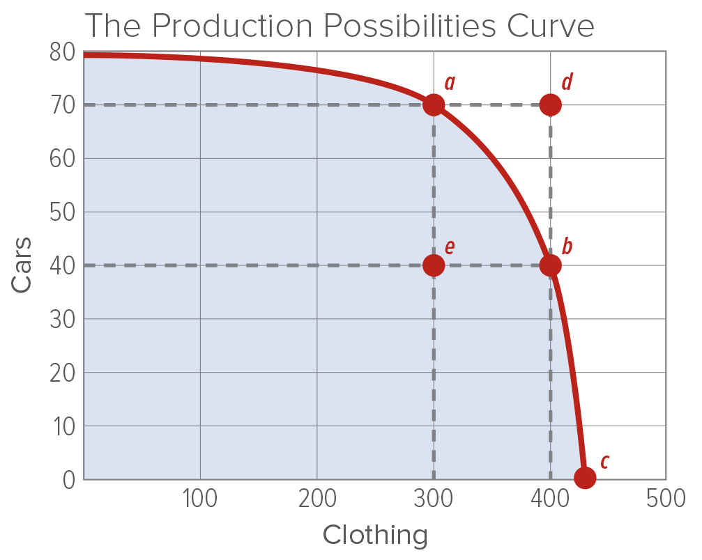
A. Identifying Alternatives
The mythical country of Alpha only produces cars and clothing. Even so, there are a number of alternatives or possibilities available to it. This is why the graph is called a Production Possibilities Frontier. (a FRONTIER is the outer limits of something)
Example A: It could choose to use all its resources to create 70 units of cars and 300 units of clothing
Example B: It could shift resources so that it produced only 40 units of cars but 400 units of clothing
Example C: The decision could be made to put all resources toward clothing and none toward cars
Even though there are lots of alternatives, Alpha will have to settle on a single combination inside the curve because resources are limited.

Slide 18
What does the PPF/PPC show?
The production possibilities curve, or frontier, shows the different combinations of two products that can be produced if all resources are fully employed.
Economic Analysis: Why can production only take place on or inside the frontier?
Production can only use current resources. Anything outside of the curve is using resources that don’t exist yet.
Points A,B, and C on the curve illustrate different combinations of fully employed resources
Point E represents production with some resources going idle (a bad thing)
Point D represents an impossibility with current resources. In order to reach D, more resources that don’t currently exist would have to be acquired.

Slide 19
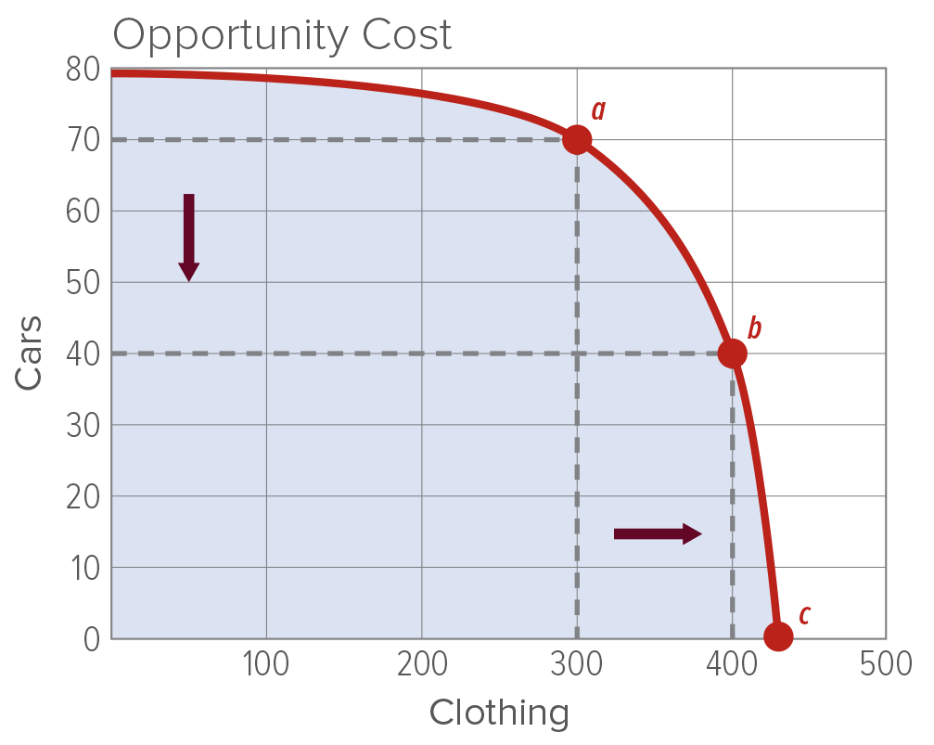
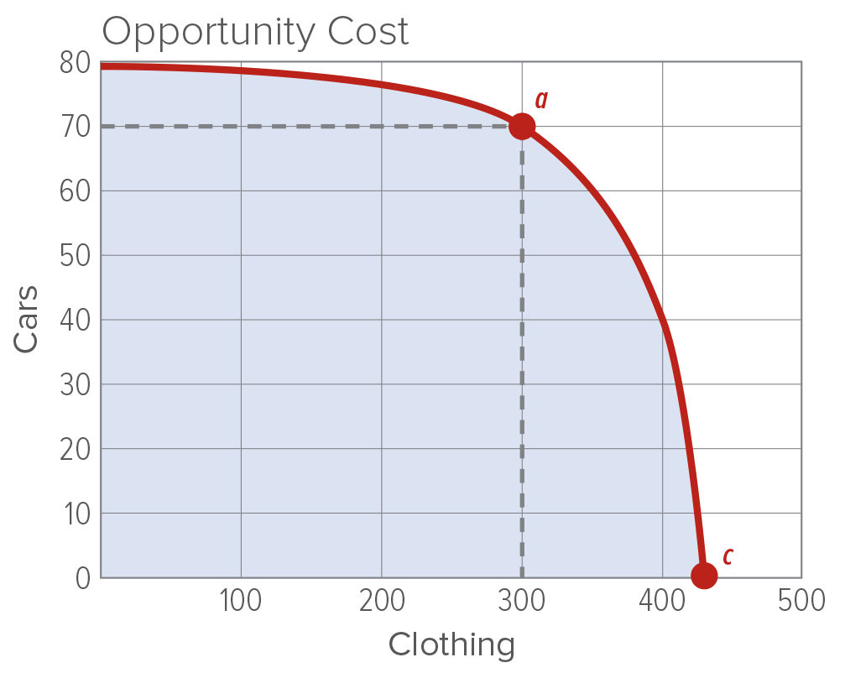
B. Opportunity Cost- the value of the next best alternative given up.
When the production for one item increases, the production of other items decreases. This can be seen above as an increase in clothing from 300 to 400 at point a causes a decline in car production from 70 to 40 at point b.
Economic Analysis: If Alpha is producing 300 units of clothing represented by point a, and if it then decides to produce the amount of clothing at point c, what would be the opportunity cost in cars?
When more than one item is manufactured, the amount of existing items must be adjusted. This reflects an understanding of opportunity cost.
70 Cars

Slide 20
A little more about Opportunity Cost
Opportunity cost doesn’t just deal with dollars and cents, it can apply to almost any choice or activity.
Example 1: You have to balance the time at your job and being with friends. If you decide to put in overtime at your job, your opportunity cost is the time you could have spent with friends. If you pend time with friends, the opportunity cost is the money you could have made at your job.
Example 2: You have $25. You have decided to spend it all on a video game or on flowers for your mother’s birthday. If you choose the game, your opportunity cost is the flowers. If you choose the flowers, your opportunity cost is the game.

Slide 21
C. The Opportunity Cost of Idle Resources
If resources are not fully employed, it would be impossible for our mythical country of Alpha to reach its PPF.
Let’s pretend that Alpha is producing at Point B when the clothing workers go on strike. This causes the total output of clothing to fall to Point E.
The production of cars doesn’t change, but the opportunity cost of the lost clothing production would be 100 units. They have lost the opportunity to make 100 additional units of clothing that they could have if all the productive resources (clothing workers) were fully employed.
Production at Point E could also be due to factories or land that are available but not being used. If any available resources are idle, the country cannot produce at its PPF. It can’t reach its full potential.

Slide 22
Videos and Extra Explanations
What is economics?
https://www.youtube.com/watch?v=3ez10ADR_gM
Production Possibilities Curve/Frontier
https://www.youtube.com/watch?v=O6XL__2CDPU
https://www.youtube.com/watch?v=83m0_pCky50
Trade-offs and Opportunity Costs
https://www.youtube.com/watch?v=9TpSCvu68rI

Slide 23
Chapter 1- Lesson 3: Using Economic Models ECONOMIC GROWTH AND INCENTIVES IN ECONOMICS
People and businesses make choices in their own BEST INTERESTS, meaning they do what is best for themselves.
For businesses, it comes down to PROFIT and CASH FLOW
For individuals, it comes down to INCENTIVES to work, save and invest

Slide 24
MARKETS
CONSUMERS and BUSINESSES come together in MARKETS
The two main markets we will talk about are the PRODUCT MARKET and the FACTOR MARKET
You take part in both markets. As a CONSUMER, you buy things in the PRODUCT MARKET. As LABOR, you sell your talents and abilities in the FACTOR MARKET

Slide 25
ECONOMIC MODELS
The INTERACTION between businesses, consumers and the government in markets can be illustrated using a diagram called the CIRCULAR FLOW MODEL
ECONOMISTS love using MODELS because they help to SIMPLIFY complex ideas

Slide 26
Circular Flow of Economic Activity Model
Another popular model used by economists to describe how our economy works is the CIRCULAR FLOW MODEL.
The Circular Flow Model shows how businesses and people connect in the MARKET.
The United States has a MARKET ECONOMY, meaning it is based on what takes place in the market between PRODUCERS and CONSUMERS
The MARKET can be an actual location, like HEB, or a mechanism, like the INTERNET, that allows businesses and people to exchange products and services for payment. They can be local, national, global or just in cyberspace!

Slide 27
The Circular Flow
The Circular Flow model has 4 parts:
The Factor Market
The Product market
Businesses(Firms or Companies or Producers)
People (Households or Individuals)

Slide 28
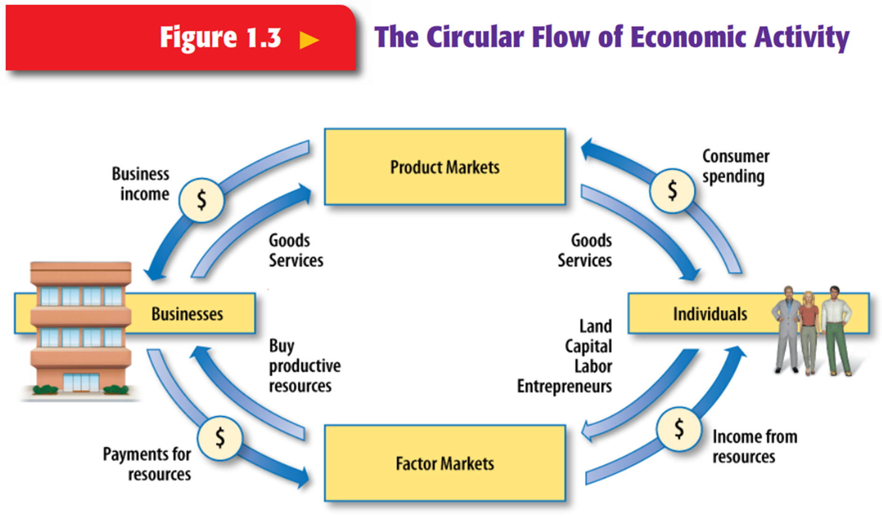

Slide 29
Factor Markets
Factor Markets are where the FACTORS OF PRODUCTION are bought and sold
In the Factor markets, Entrepreneurs…
HIRE LABOR to work in their businesses and pay labor WAGES AND SALARIES
ACQUIRE LAND in return for RENT
BORROW MONEY in return for INTEREST PAYMENTS to establish and run the business
Buy CAPITAL GOODS like business or construction equipment
Factor Markets include labor market, raw material market, commercial real estate market, capital goods markets
You participate in the Factor Market when you SELL your LABOR to an employer and receive WAGES in return.

Slide 30
Product Markets
Product Markets: markets where PRODUCERS offer goods & services for sale to CONSUMERS(sometimes called a CONSUMER MARKET)
In the Product Market, consumers purchase goods and services to satisfy their wants and needs
EXAMPLE: Macy’s, HEB, Walmart, Target, Whole Foods
You PARTICIPATE in the Product market when you take the money you made by SELLING your labor in the Factor Market and use it to BUY goods and services in the Product Market.
Businesses take the MONEY you gave them in the Product Market and use it to CREATE more goods and services in the Factor Market.

Slide 31
All circular flow diagrams will be handed out separately. Be sure to put them behind these pages in the note section of your notebook

Slide 32
PRODUCT MARKET
BUSINESSES/ PRODUCERS
CIRCULAR FLOW OF ECONOMIC ACTIVITY
HOUSEHOLDS/
INDIVIDUALS
FACTOR MARKET

Slide 33
PRODUCT MARKET
BUSINESSES/ PRODUCERS
HOUSEHOLDS/
INDIVIDUALS
GOVERNMENT
FACTOR MARKET

Slide 34
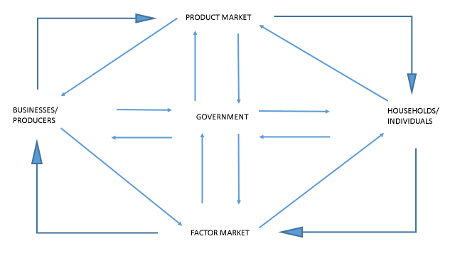

Slide 35
The Role of Markets
The CIRCULAR FLOW MODEL has no beginning or end
You can start with people going to WORK and earning WAGES in the factor market or with BUSINESSES selling their PRODUCTS in the product market
The most important point is that PEOPLE AND BUSINESSES are connected by MARKETS.
You have never met the person who made your shoes or car and they have never met you. You are connected by the market that brought you together.

Slide 36
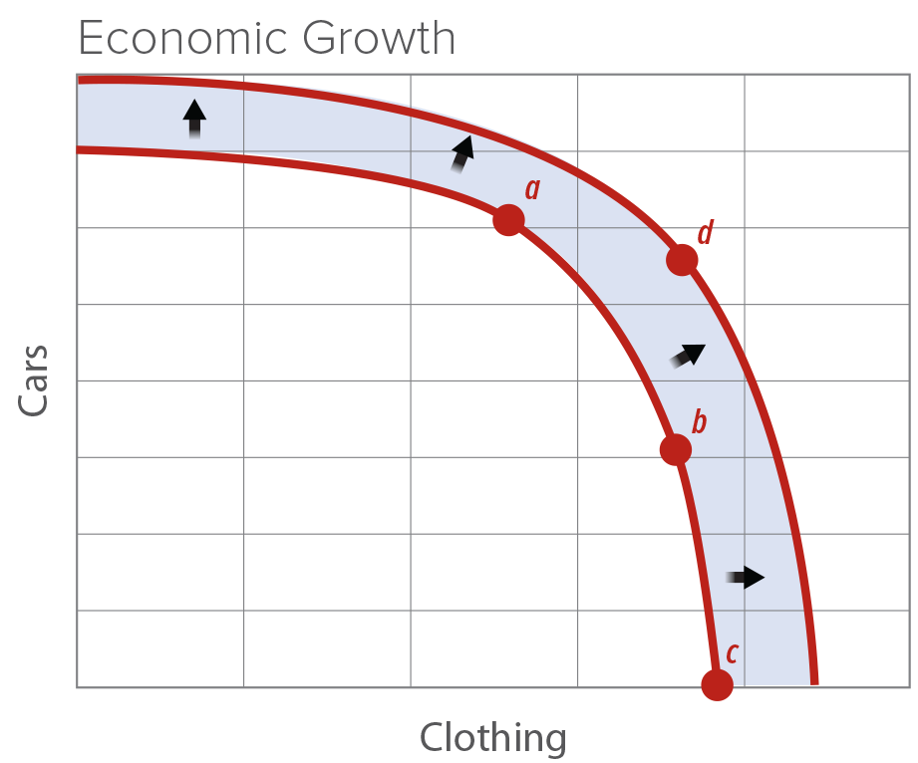
Using Models to Describe Economic Growth
The easiest way to describe ECONOMIC GROWTH is by using the Production Possibilities Frontier Curve again..
You already know that it shows the various combinations of products an economy can produce if all resources are fully employed. But it can also show economic growth and increased productivity
Sometimes something happens to push the PPF OUTWARDS: improved TECHNOLOGY, access to more natural RESOURCES, an influx of skilled IMMIGRANTS, etc.
Any of these positive changes could cause or mythical country of Alpha to produce at levels it could not before. In other words, the PPF expands to reach POINT D.

Slide 37
These notes will be handed out separately. Be sure to put them behind this section of notes in your notebook

Slide 38
Economic Growth Chart
These notes will be handed out separately. Be sure to put them behind this section of notes in your notebook
Economic growth is made possible by the addition of MORE RESOURCES or by an INCREASE in PRODUCTIVITY.
When these changes are realized, the economic model is adjusted to reflect an EXPANDED economic frontier that can accommodate the growth POTENTIAL.
New PPF showing the addition of new resources or productivity
Old PPF

Slide 39
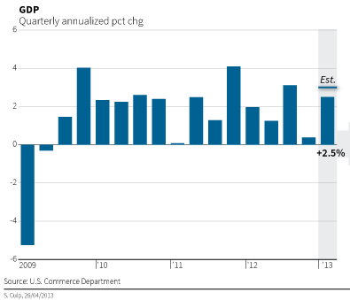
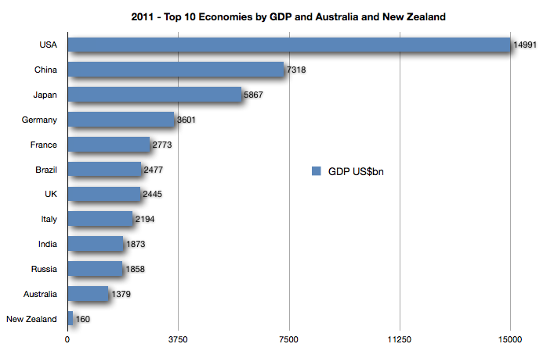
PROOF OF ECONOMIC GROWTH:GDP - Gross Domestic Product
GROSS DOMESTIC PRODUCT (GDP)– The dollar value of a goods, services and structures produced within a country’s borders in a 12 month time period
Gross Domestic Product is one of the best ways of calculating a nation’s economic HEALTH and economic GROWTH.

